Slide 1
DJANGO generic display view
江琳

Slide 2
generic view

Slide 3
Generic view
In some cases, writing views, as we have seen earlier is really heavy.
Generic views take certain common idioms and patterns found in view development and abstract them so that you can quickly write common views of data without having to write too much code.

Slide 4
Generic view
Unlike classic views, generic views are classes not functions.
Django offers a set of classes for generic views in django.views.generic, and every generic view is one of those classes or a class that inherits from one of them.

Slide 5

Generic view
Open the terminal and type below:
>>> import django.views.generic
>>> dir(django.views.generic)
['ArchiveIndexView', 'CreateView', 'DateDetailView', 'DayArchiveView', 'DeleteView', 'DetailView', 'FormView', 'GenericViewError', 'ListView', 'MonthArchiveView', 'RedirectView', 'TemplateView', 'TodayArchiveView', 'UpdateView', 'View', 'WeekArchiveView', 'YearArchiveView', '__all__', '__builtins__', '__cached__', '__doc__', '__file__', '__loader__', '__name__', '__package__', '__path__', '__spec__', 'base', 'dates', 'detail', 'edit', 'list']

Slide 6
generic display view

Slide 7
Generic display view
Generic display views are designed to display data. On many projects they are typically the most commonly used views.
ListView
DetailView

Slide 8
detailview

Slide 9
DetailVIew
class django.views.generic.detail.DetailView
DetailView uses to get and return a object from a model.

Slide 10

DetailVIew
Let’s modify the BookDetail view using DetailView
class BookDetail(DetailView): model = Book template_name = 'detail.html’
# in url.py url(r'^book/(?P<pk>\d+)/', BookDetail.as_view(), name='book_detail'),

Slide 11

DetailVIew
<!DOCTYPE html> <html> <head> <meta charset="UTF-8"> <title>{{ object.name }}</title> </head> <body> <h1>{{ object.name }}</h1> <span> <b>Author:</b> {{ object.author }} <b>Publish by:</b>{{ object.publisher.name }} <b>Release at</b>:{{ object.pub_year }} </span> <h2>Introduction</h2> <div>{{ object.intro }}</div> </body> </html>

Slide 12
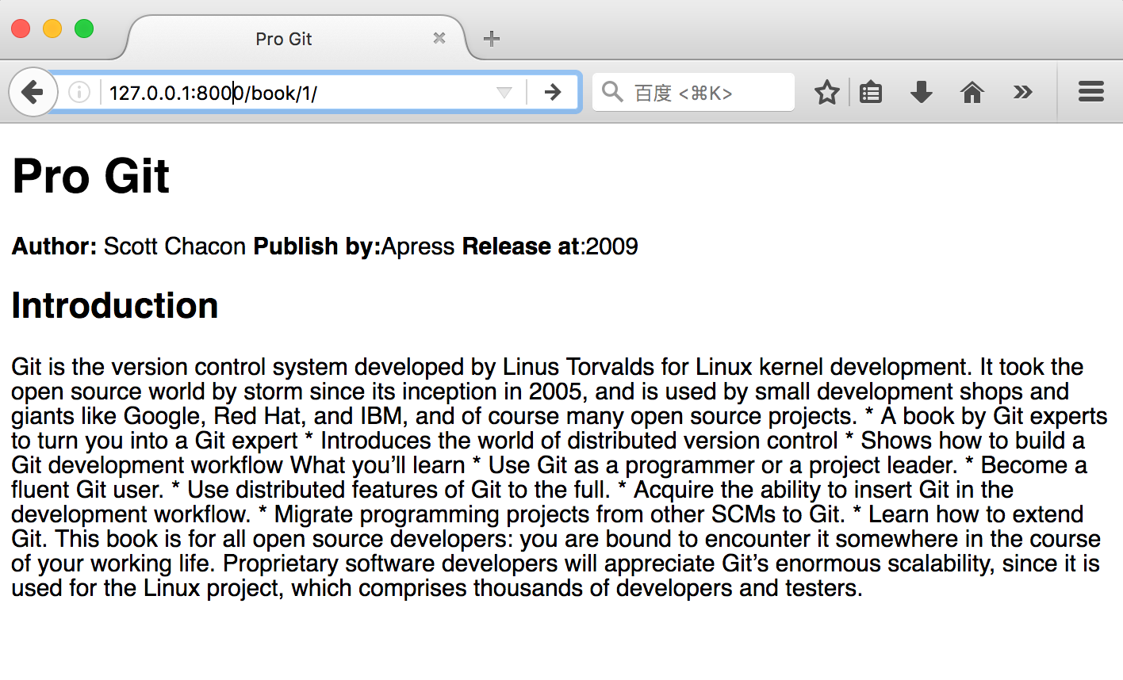
DetailVIew

Slide 13
DetailVIew
Methods:
dispatch() | http_method_not_allowed()
get_template_names() | get_slug_field()
get_queryset() | get_object()
get_context_object_name() | get_context_data()
get() | render_to_response()

Slide 14
DetailVIew
get_context_data()
Returns context data for displaying the object.
It returns a dictionary with these contents:
object: The object that this view is displaying (self.object).
context_object_name: self.object will also be stored under the name returned by get_context_object_name(), which defaults to the lowercased version of the model name.

Slide 15

DetailVIew
In default
class BookDetail(DetailView): model = Book template_name = 'detail.html' def get_context_data(self, **kwargs): context = super(BookDetail, self).get_context_data(**kwargs) return context

Slide 16

DetailVIew
If we want to passing extra field to template, we can write like below: (passing now to template)
class BookDetail(DetailView): model = Book template_name = 'detail.html' def get_context_data(self, **kwargs): context = super(BookDetail, self).get_context_data(**kwargs) context['now'] = datetime.now() return context

Slide 17
listview

Slide 18
Library system
Part one: Library System
Homepage
Book list page
Book detail page
Part two: Library Management System
Login page
Create book, author, publisher, category
Book list
Update book

Slide 19

listview
Let’s write a page to list of books using ListView
class BookList(ListView): model = Book template_name = 'list.html'

Slide 20

listview
<!DOCTYPE html> <html lang=“en”> <head> <meta charset=“UTF-8”> <title>Book List</title> </head> <body style=“width: 80%”> <div style=“text-align: center”><h1>Book List</h1></div> {% for obj in object_list %} <span style="font-size: 20px;
font-weight: bold">
{{ obj.name }}</span> <span>--{{ obj.author.name }}</span><br> {% endfor %} </body> </html>

Slide 21
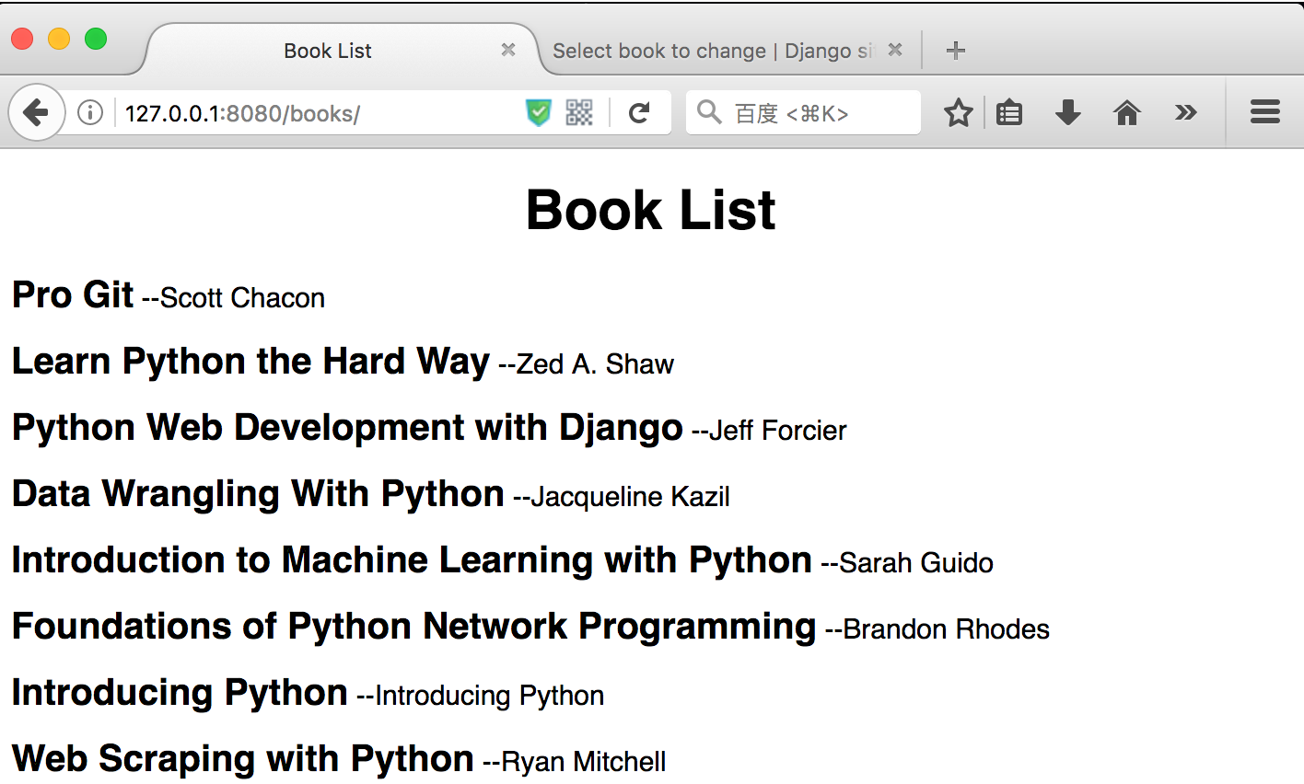
listview

Slide 22
listview
methods
dispatch() | http_method_not_allowed()
get_template_names() | get()
get_queryset() | render_to_response()
get_context_object_name() | get_context_data()

Slide 23

listview
get_context_data()
Returns context data for displaying the list of objects.
class BookList(ListView): model = Book template_name = 'list.html' def get_context_data(self, **kwargs): context = super(BookList, self).get_context_data(**kwargs) context['now'] = datetime.now() return context

Slide 24
listview
Context:
object_list: The list of objects that this view is displaying. If context_object_name is specified, that variable will also be set in the context, with the same value as object_list.
is_paginated: A boolean representing whether the results are paginated. Specifically, this is set to False if no page size has been specified, or if the available objects do not span multiple pages.
paginator: An instance of django.core.paginator.Paginator. If the page is not paginated, this context variable will be None.
page_obj: An instance of django.core.paginator.Page. If the page is not paginated, this context variable will be None.

Slide 25
listview
get_queryset()
Get the list of items for this view. This must be an iterable and may be a queryset
class BookList(ListView): model = Book template_name = 'list.html' def get_queryset(self): queryset = super(BookList, self).get_queryset() return queryset

Slide 26

listview
Now, we modify BookList view to get book list based on name of book
class BookList(ListView): model = Book template_name = 'list.html' def get_queryset(self): name = self.request.GET.get('name') queryset = super(BookList, self).get_queryset() if name: queryset = Book.objects.filter(name__icontains=name) return queryset

Slide 27
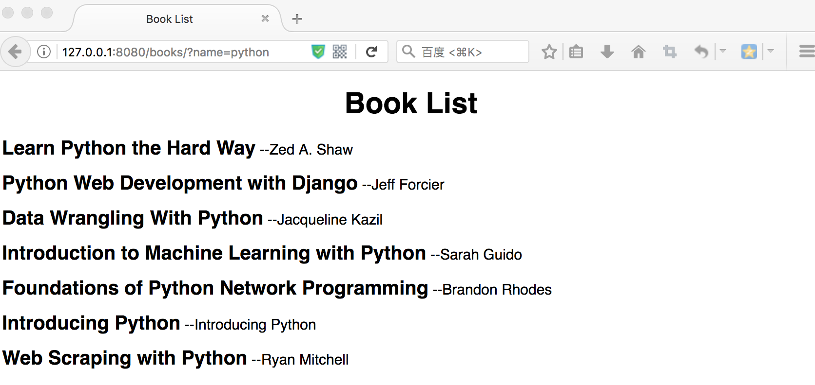
listview
Now open link: 127.0.0.1/books/?name=python

Slide 28
Library system

Slide 29
homepage
Let modify the home view and html
# home view def home(request): return render(request, 'homepage.html')

Slide 30

homepage
# homepage.html
<!DOCTYPE html> <html lang="en"> <head> <meta charset="UTF-8"> <title>Library System</title> </head> <body style="text-align: center"> <h1>Library System</h1> <form method="get" action=""> <input type="text" style="width: 60%;height: 30px" placeholder="searching"> <input type="submit" value="Search"> </form> </body> </html>

Slide 31
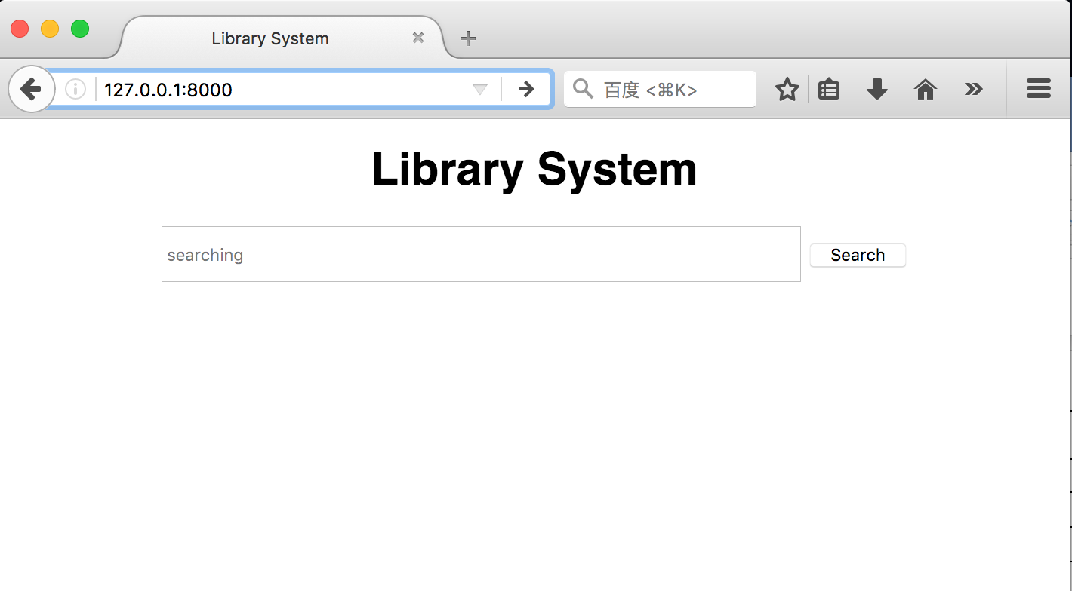
homepage
now we can search book using book’s name on Homepage.

Slide 32
Namespacing URL names
Modify homepage.html
<!DOCTYPE html> <html lang="en"> <head> <meta charset="UTF-8"> <title>Library System</title> </head> <body style="text-align: center"> <h1>Library System</h1> <form method="get" action="{% url 'book_list' %}"> <input type="text" style="width: 60%;height: 30px" placeholder="searching" name="name"> <input type="submit" value="Search"> </form> </body> </html>

Slide 33
Namespacing URL names
Modify list.html
<body> <div style="text-align: center"><h1>Book List</h1></div> {% for obj in object_list %} <a href="{% url 'book_detail' pk=obj.id %}"> <span style="font-size: 20px;font-weight: bold">{{ obj.name }}</span> <span>--{{ obj.author.name }}</span><br> </a> {% endfor %} </body>

Slide 34
Questions?

